Slide 1
OBSERVING NON VERBAL CUES
GROUP-3

Slide 2
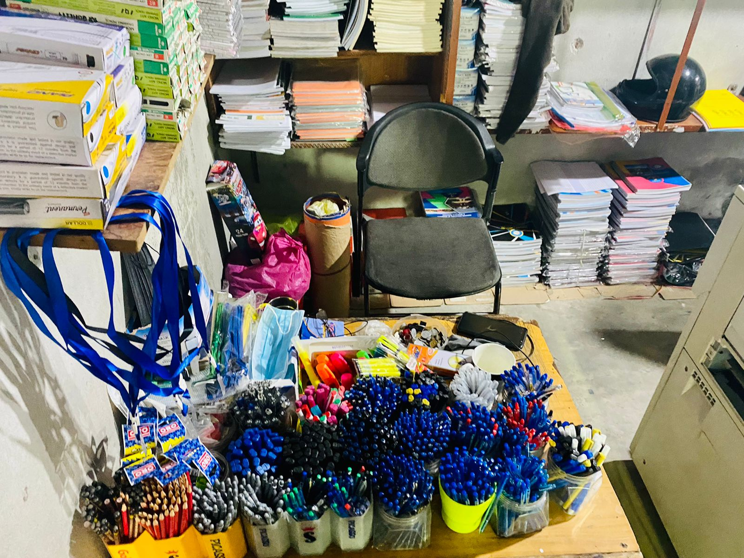
IntroducTion
Observing verbal/non-verbal communication
Photocopier Shop
People in shop
2 Managers
2 Workers
1 Costumer (excluding us)

Slide 3
Contexts

Slide 4
Social context
Within Workers
Workers and Customers
Comfortable with each other
Less verbal communication
Conversating with non-verbal cues (actions)
Not familiar with each other
Using verbal methods of communications

Slide 5
Physical COntext
Small shop
Participants were closer to each other
Dim lighting
Time 9:00 am (early)
Noise levels were low

Slide 6
Historical COntext
No Historical Context
Little to no communication
Early in the morning

Slide 7
Psychological COntext
The mood was calm
Participants were focused on their tasks
Minimal conversation
Workers were serious and helpful towards the customers

Slide 8
Cultural COntext
Hand shake (Asalam-o-Alaikum)
Younger workers were working more than the older ones.
Age of workers were proportional to the hierarchy of the shop
Common practice seen in several other workplaces

Slide 9
Types of Communications
Intrapersonal
Interpersonal
Manager was watching news
One worker was humming to himself
In between the workers
Cashier and customers
No other communications
No Small group/Public gathering

Slide 10
Non verbal cues used/Not used

Slide 11
Use of Body
Nodding to each other to convey message(hand gestures)
Eye contact with the customers
Workers looked bored as they did not have much to attend to
Relaxed posture, casual towards the costumers
Haptics: Used slightly while communicating (greetings)

Slide 12
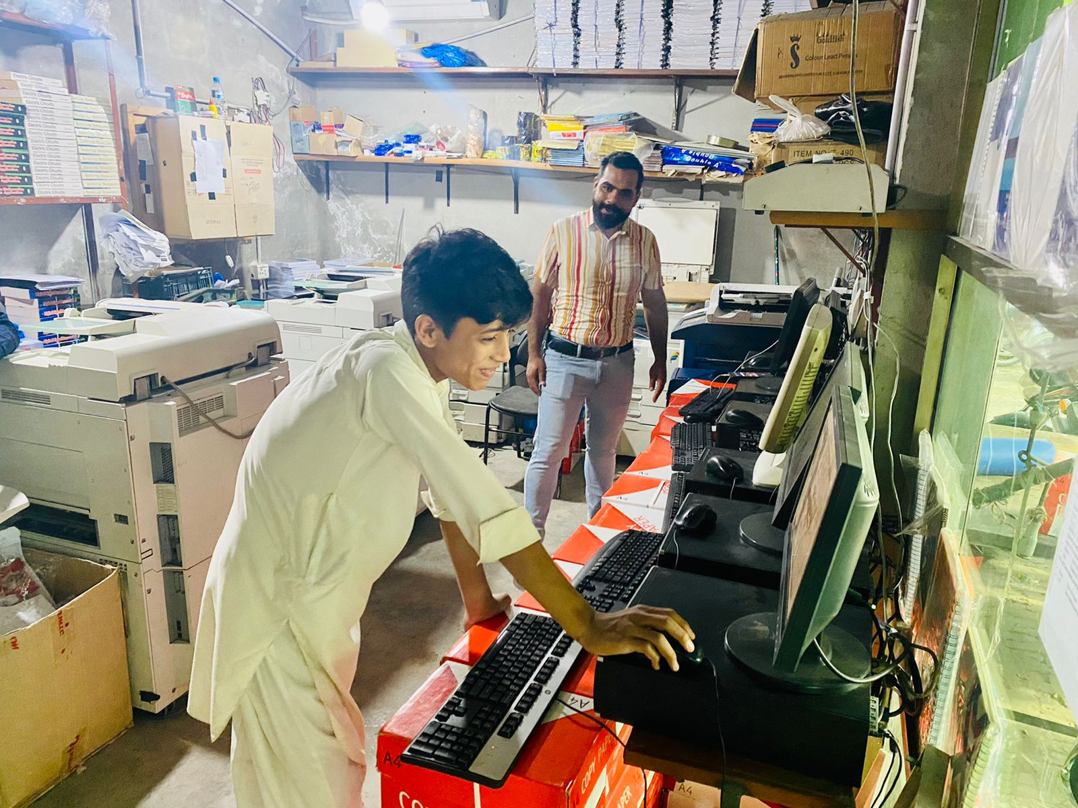
Use of Voice
Used slightly
Exchange of money
Low pitch, gets high when question asked
Low volume kept by the participants
Quality of voice was raspy of the workers because they were stage whispering
No fluctuation in the tone
Vocalized pauses used by customer when asking for items they needed

Slide 13
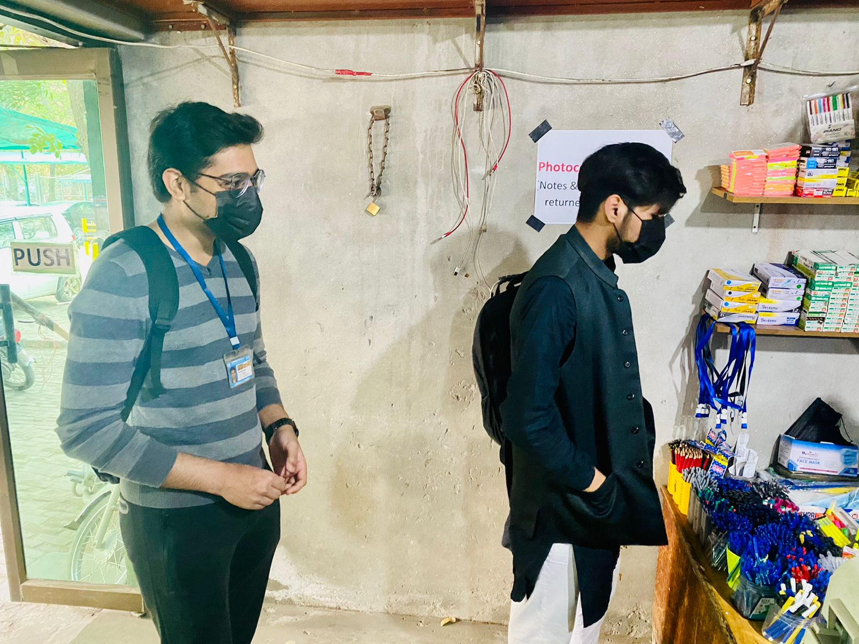
Use of Space
Personal Space: Customers were practicing social distancing
Personal space was crossed when greeting
Physical Space: Manager’s space was his table, photocopiers space consisted of the photocopy machine
No personal artifacts
Books, stationary, Photocopied books
The drawer with the money was in front of the manager
Ink cartridges and A4 papers were within the workers reach

Slide 14
Use of time
Monochronic: Not a lot of work load
Polychronic: Not used, applied when more customers are present
Fewer customers early in the morning

Slide 15
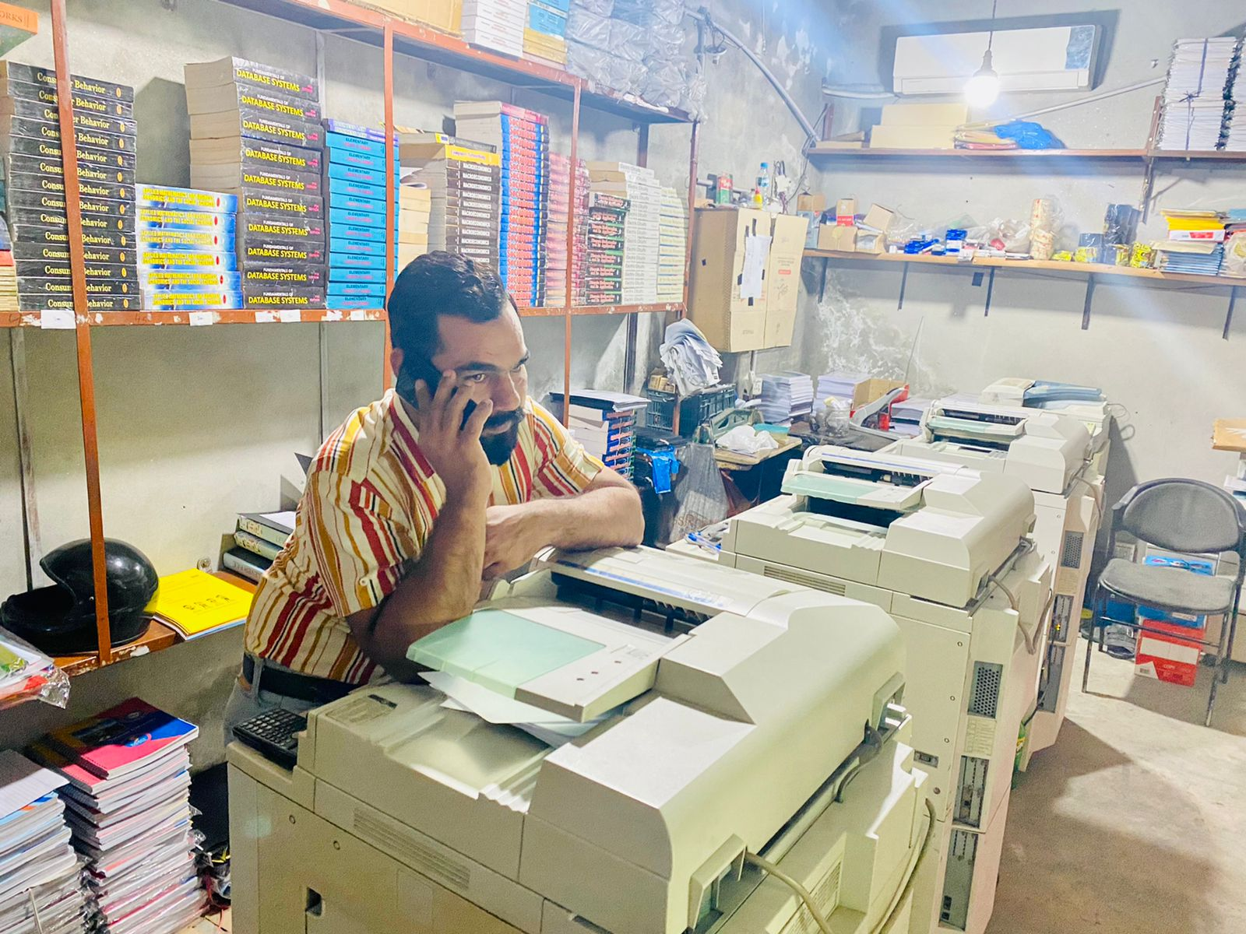
Self Presentation cues
Endomorphs: Both Managers
Mesomorphs: None present
Ectomorph: workers standing and doing physical work

Slide 16
Clothing and grooming
Cultural clothing
Shalwar Kameez
Comfortable and casual clothing
No one was wearing

